Slide 1
FDA 21 CFR Part 11 Compliance
Charles Yan, PhD
Senior Director, Clinical Data Management
Jiangsu Hengrui Pharmaceutical Co. LTD

Slide 2
Topics
What is Part 11
Background
Scope and Component Requirements
FDA 21CFR11 Inspection Questions
Implementing CFR Part 11
Summary

Slide 3
What is Part 11
21 CFR Part 11 (Part 11) applies to electronic records and electronic signatures that persons create, modify, maintain, archive, retrieve, or transmit under any records or signature requirement set forth in the Federal Food, Drug, and Cosmetic Act, the Public Health Service Act, or any FDA regulation.

Slide 4
Other Names in the industry
Official Name
US Food and Drug Administration Code of Federal Regulations, Title 21, Part 11
Other Names
21 Code of Federal Regulation Part 11
21 CFR Part 11
Part 11
CFR Part 11

Slide 5
Background
Computerized systems are widely used pharmaceutical industry from early development, clinical trials and manufactures
20th August 1997, FDA Title 21 CFR Part 11:Electric Records. Electric Signatures; Final Rule has initially published after industrial-FDA task force started in 1991
Provided criteria under which FDA will consider electric records to be equivalent to paper records and electric signature equivalent to traditional handwritten signature
High profile audit findings
Industrial complaints to wasting resources and non-value added
August 2003 FDA: Guidance for Industry Part 11, Electronic Records; Electronic Signatures — Scope and Application
Guideline is not law
FDA’s current thinking
In some areas, the 2003 guidance contradicted requirements in the 1997 Final Rule
2007 FDA: Guidance for Industry Computerized Systems Used in Clinical Investigations
Supplements the previous guidelines
Defines the scope of CFR Part 11 and when it applies

Slide 6
Electronic Records/Electronic Signatures
Every piece of data for Clinical Trials is handled or transmitted electronically
Scientifically, the integrity and non-repudiation of electronic records must be ensured
Regulatory agencies inspect Sponsors, Investigators, CROs, and Vendors to ensure CFR 21 Part 11 is being met
Signatures and Records are Different
Electronic Record is data, field, document, page
Electronic Signature is computer representation of a handwritten signature
Ensure the integrity and non-repudiation of electronic records
Allows the ability to attach signature(s) to electronic records
Reduces process time and cost

Slide 7
Scope of Part 11
Effective since April 1997
Affects databases, file storage, images
Electronic data collection at Investigators, CROs, and Vendors
Complexity of Auditing
Data Validity
Business Practices

Slide 8
Components of Electronic Records
All Electronic records fall under Part 11
Audit Trails (11.10e)
Limited Access (11.10d)
Authority Checks (11.10g)
Document Controls (11.10k)
Generate copies of data (11.10a-b)
Operational Workflow (11.10f)
Data Validity Checks (11.10h)
Training (11.10i)
Written Policies (11.10j)
Validation of systems (11.10a)
Closed system plus encryption and protection for records (11.30).
If the persons responsible for the content of electronic records also have control of system access, the system is ‘closed’. If the persons responsible for content of electronic records do not have control of system access, the system is ‘open’ (i.e. internet). Open systems require the added assurance that records are protected from point of creation to receipt

Slide 9
Components of Electronic Signatures
Biometric (retina scans, voice recognition, fingerprint) (11.200 b)
User ID/Password (11.200a)
Record Binding - signature is embedded /linked to the record (11.70)
Security - Controls, uniqueness, periodic checks, management, safeguards (11.300 abcde)

Slide 10
Overall Approach to Part 11 Requirements
Limiting system access to authorized individuals
Use of operational system checks
Use of authority checks
Use of device checks
Determination that persons who develop, maintain, or use electric systems have the education, training, and experience to perform their assigned tasks
Establishment of and adherence to written policies that hold individuals accountable for actions initialed under their electric signatures
Appropriate controls over system documentation
Controls for open system corresponding to controls for closed system
Requirement related to electric signatures

Slide 11
FDA 21CFR11 inspection questions
Who is allowed to input data？
Who is allowed to change data？
How can you tell who entered the data？
How do you know which data had been changed？
When do you lock down the data input？
Can you do the following actions？ “Show me some data, show me you can see the history of the data, show me you control the data life cycle.”
Is the system validated and are the requirements met？
Can you show me the results of the validation activities？
Does the validation include: “Pass/fail, signature, date/time stamp”; and “objective evidence - screen prints or page printouts with a link to the direction that generated the output.”？

Slide 12
Warning Letter
In addition to the above listed violations, our Investigator noted that the laboratory is using an electronic record system for processing and storage of data from the atomic absorption and HPLC instruments that is
not set up to control the security and data integrity in that the system is not password controlled,
there is no systematic back-up provision, and
there is no audit trail of the system capabilities.
The system does not appear to be designed and controlled in compliance with the requirements of 21 CFR, Part 11, Electronic Records.

Slide 13
More FDA Inspection Findings for Part 11
Citations of insufficient integrity, security, and availability of electronic records and validation of software and computer systems
Insufficient Data Security with Ability to Overwrite Data
Computer Validation at the Vendor's Site is not Enough
Legacy Computer Systems not Validated
Off-the-shelf Software such as Microsoft Word and Microsoft Excel not Validated
Inadequate Storage and Back-up and no Correlation Between Electronic and Paper
Accuracy of Inputs to and Outputs from HPLC Instruments not Checked
Databases for Data Analysis and Other Tracking and Trending Functions not Validated (W-179)
Electronic Raw Data not Saved
Part 11 Advice for Hybrid Complaint Management Data Base (W-166)
Electronic Data Changed After Approval by the Supervisor (W-165)
Falsified Electronic Records Generated in Tests of Drugs Led to Bankruptcy of a Drug Manufacturer
No Formal Risk Analysis after Software Changes
No Revalidation after Software Changes
No Backup Procedures and No Validation of Computer Systems (W-138)
Software not Revalidated after Changes
FDA Presentation: Electronic Data Integrity and Fraud - Another Looming Crisis?
http://www.labcompliance.com/solutions/expert_advice/part11/fda_inspections_2004-2007.aspx

Slide 14
Part 11 Issues
Audit Trails – How much?
Vague – Interpretation differences are substantial in terms of cost and audit issues
Different interpretations from company to company
Maintaining original and copies of electronic records – Technology obsolescence

Slide 15
Part 11 Advantages
Speed, audit ability and accountability
Paperless records and collection and storage
Data guarantees
Authenticity, Data integrity, Non-repudiation, Confidentiality of records
Electronic record audit trail
Easy access to electronic records

Slide 16
Implementing CFR 21 Part 11
All systems that manage data for clinical trials need to be compliant
Need to have your organization’s interpretation of Part 11 documented and how you plan to move forward with it
Creation of a checklist for ensuring Part 11
Don’t create documents just to meet Part 11 Make sure that you take advantage of what it does to build in data integrity

Slide 17
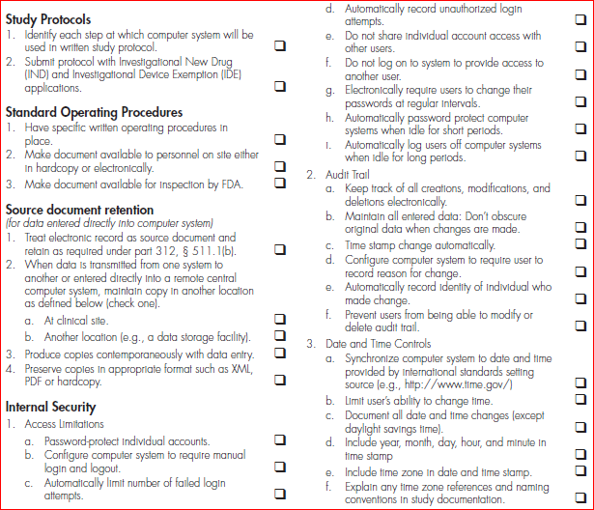
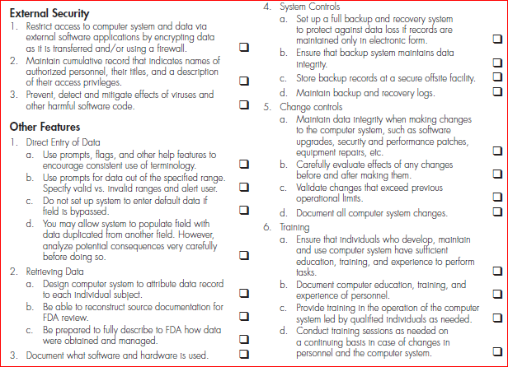
21 CFR Part 11 Checklist

Slide 18
Summary
Part 11 is important to all systems in Clinical Trials
Electronic data collection and eClinical systems
Ensure all your vendors document how the system is Part 11 compliant
Be prepared for audits
Administrative controls
Procedural controls
Technical controls
Quality & integrity are key outcomes of Part 11

